Slide 1

Pens and Printers New Products
Sales Analysis
By Eti-ini Umoh

Slide 2

Outline
Business goals
Outcomes
Business Metrics
Recommendations

Slide 3
Business goals
The company has launched a new line of products of office stationery and would want to find out the best sales strategies to market the new line of products to customers.The sale team would like to know the following insights:
The number of customers for each approach
The spread of the revenue overall and the spread of revenue for each each sales method
Difference in revenue over time for each of the methods
The best recommended method(s) for marketing based on the provided data

Slide 4
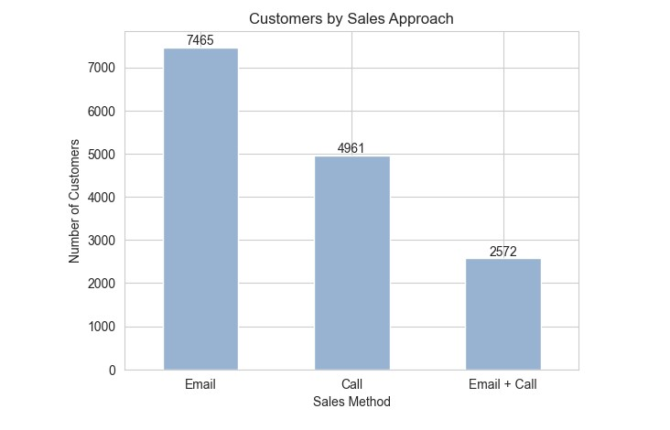
Outcomes
The number of customers for each approach
Looking at the chart, the sales team reached the most customers through the ‘Email’ approach (50%), followed by the ‘Call’ approach(33%) and lastly the ‘Email + Call’ approach(17%).

Slide 5
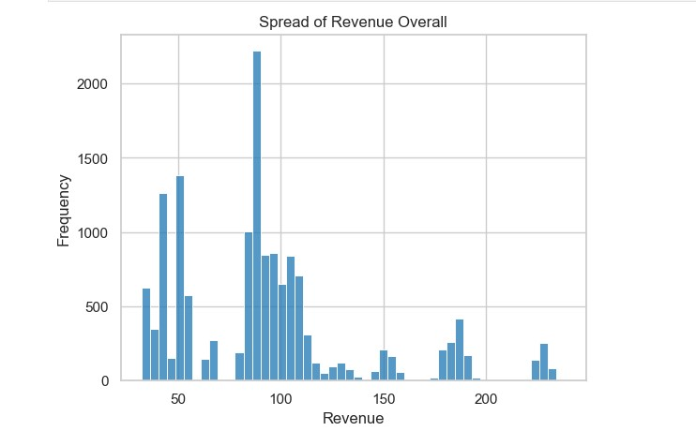
Outcomes
The spread of the revenue overall
Looking at the distribution for the overall revenue, most of the sales fell in the range of 32-110. The maximum revenue is 238.32 while the minimum revenue is 32.54. The range of 205.78 shows a wide spread of the revenue. The average revenue is 93.62.

Slide 6
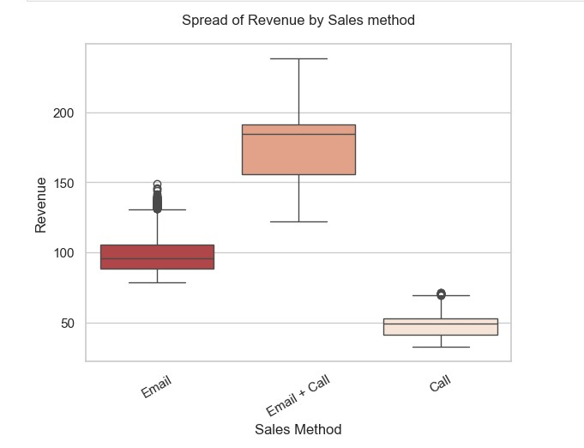
Outcomes
The spread of the revenue for each sales method
Looking at the boxplot for each sales method, Email+ Call approach has the most significant revenue spread, followed by the Email approach and lastly the Call approach

Slide 7
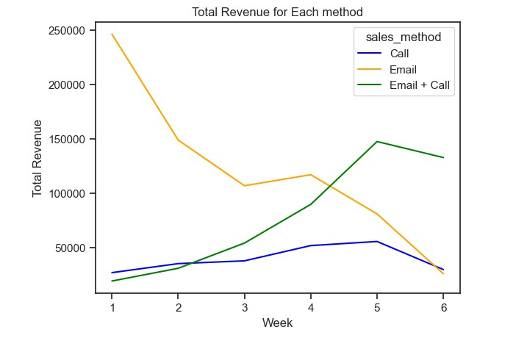
Outcomes
Difference in revenue over time for each of the methods
Looking at the change in total revenue over time as shown in the line plot, ‘Email’ sales method produced the highest total revenue in week 1 but declined gradually until week 6 when it became less than 50000. The ‘Email + Call’ approach however, experienced a steady rise in total revenue and also a slight decrease in week 6. Finally, the ‘Call’ approach was almost constant throughout the 6 weeks.

Slide 8
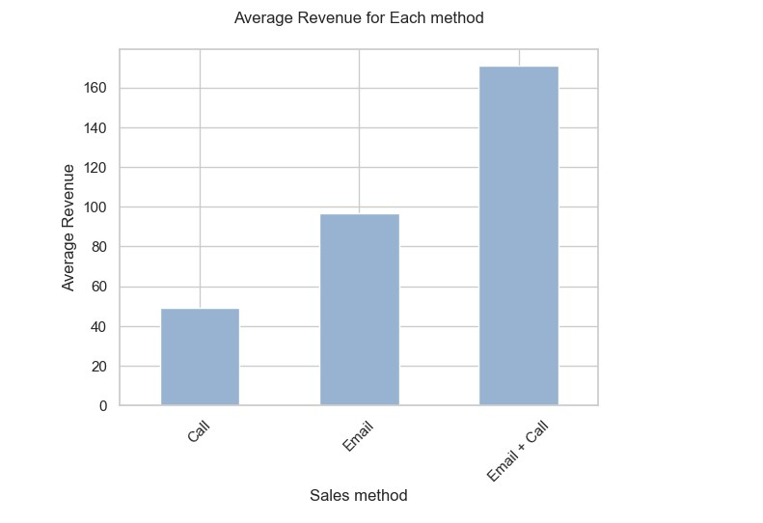
Outcomes
The best method(s) for marketing based on the provided data
Based on the average revenue of the sales method, I would recommend:
Discontinuing the ‘Call’ approach due to low revenue and time/cost requirements.
Adopting the ‘Email + Call’ as the primary strategy given its high average revenue and fairly lower time compared to the ‘Call’ approach.
The ‘Email’ approach can be continued as a secondary strategy considering its low cost and time requirements.

Slide 9
Business Metrics
The metrics the business should monitor is the average revenue generated by the business. Looking at the ‘Email + Call’ approach in the past 6 weeks, the average revenue generated was 170.88, to measure an increase in sales, the average revenue should not go below 170.88.

Slide 10
Recommendations
For the following weeks, my recommendation would be:
o Focusing on ‘Email + Call’ method alongside Email approach because of its less cost. Call approach should be discontinued entirely.
o Using key business metrics as stated earlier to track sales growth.
o Use sales strategy including loyalty campaigns and offer discounts to long time customers to improve sales
o Data Collection for in-depth analysis.
Data about the type of products being purchased by the customers to analyze the what sells most in order to improve the sales of products that are sold less.
The Data collection process should be improved to prevent reoccurrence of missing values.

